Slide 1

Model-BASED Design (MBD)
Advanced Driver Assistance System (ADAS) – Part i: Vehicle Direction Detection
By: Ahmed Mohsen Abouelyazed

Slide 2
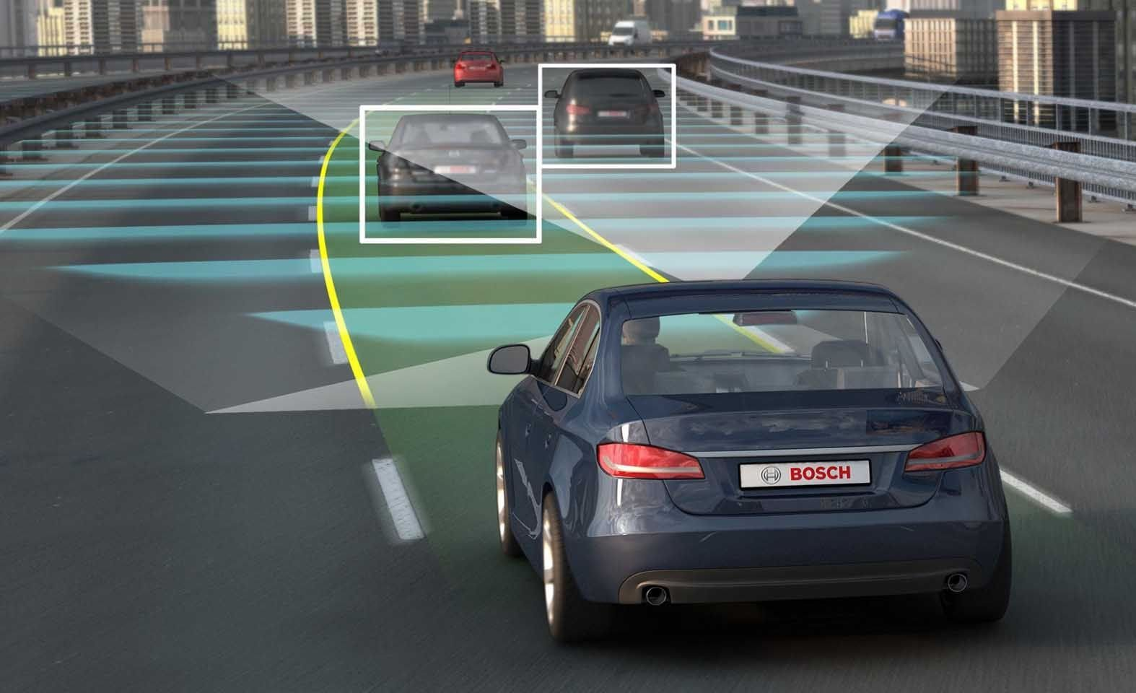
🔹 What is ADAS?
What is ADAS?
Advanced Driver Assistance Systems (ADAS) enhance vehicle safety by reducing human error.
Uses cameras, sensors, and AI for real-time driving assistance.
Key Features:
Pedestrian Detection, Lane Departure Warning, Traffic Sign Recognition, Automatic Braking, Blind Spot Detection, and Vehicle Direction Detection.
Objective of this Project:
Develop a MATLAB Simulink model for Vehicle Direction Detection.
Validate and verify it using the V-Model approach.

Slide 3
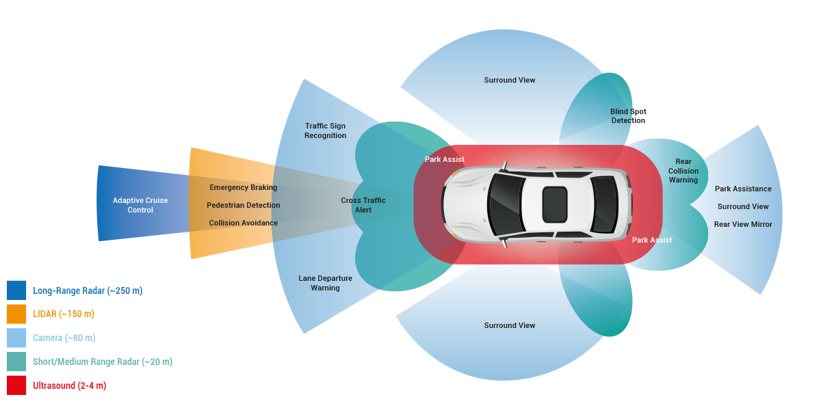
🔹 System Requirements
🔸Requirement 1: Detecting Steering Direction
Input: Yaw Rate (Steering_Input_YawRate)
Compare with predefined thresholds:
Right Turn if > 30°
Left Turn if < -120°
Straight otherwise
Store result in Turn_Direction_Status
🔸 Requirement 2: Confirming Turn Using Road Signs
Compare Turn_Direction_Status with road sign data (RoadSign_Input_Camera)
If they match, confirm direction in Direction_Indicator_Output (Boolean 1/0)

Slide 4
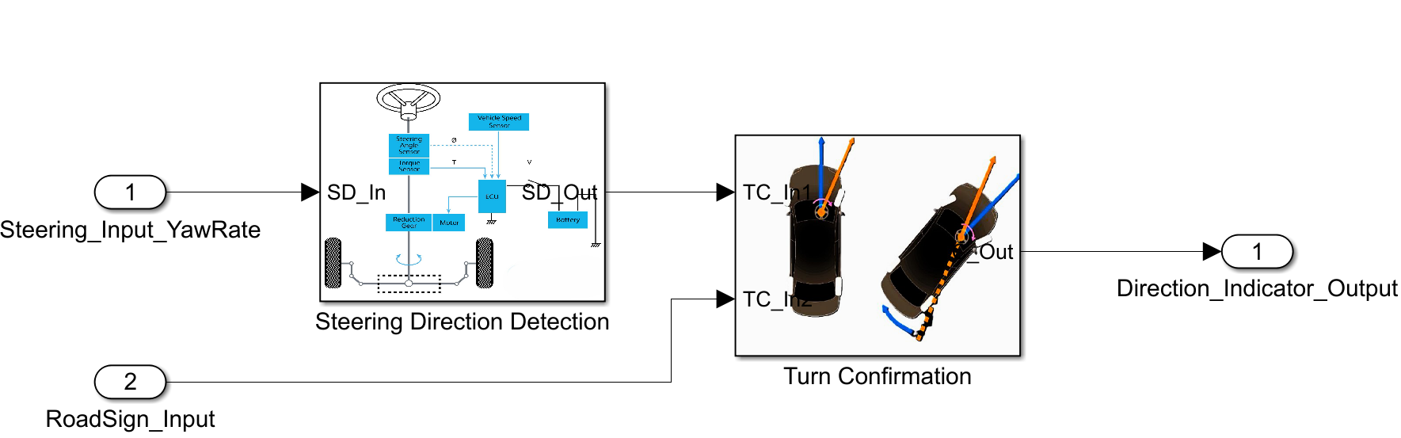
🔹 Simulink Model Architecture
🔸 Subsystems:
Steering Direction Detection Subsystem: Determines turn direction.
Turn Confirmation Subsystem: Verifies detected turn using road sign input.
🔸 Block Diagram Representation
the Simulink Model is shown in the picture.

Slide 5

Model-BASED Design (MBD)
PART II: V-Model Approach in ADAS Development

Slide 6
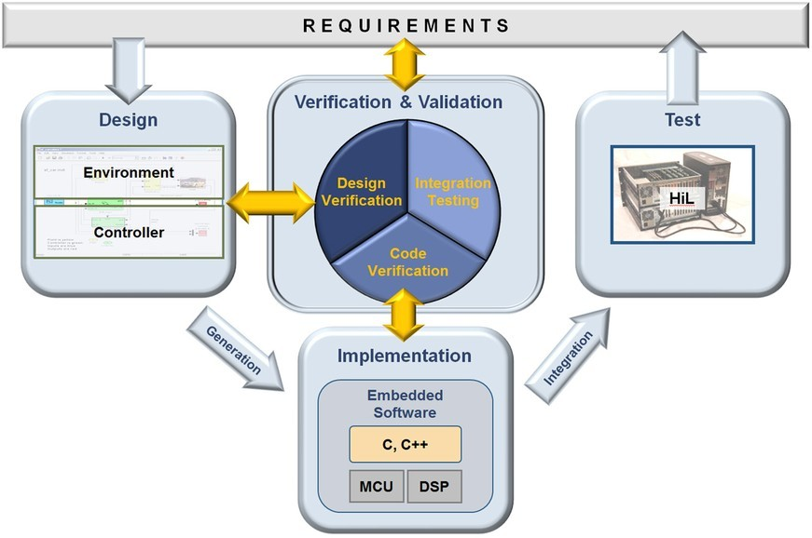
🚀 V-Model Approach in ADAS Development
🔎 The Model-Based Design (MBD) Process follows a structured approach to develop, simulate, test, and deploy control systems, ensuring efficiency and reliability.
One of the most powerful methodologies in MBD is the V-Model. But why is it so important? 🤔

Slide 7
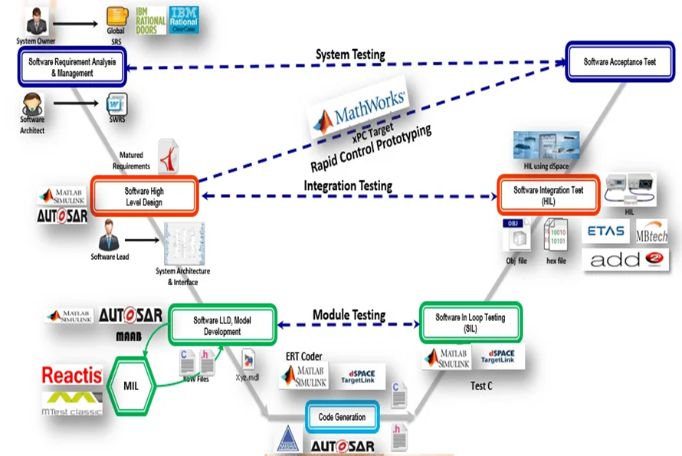
🚀 V-Model Approach in ADAS Development
🔻 Left Side – System Design & Decomposition 1️⃣ Requirements Definition (System-level specs & constraints) 2️⃣ System Design (Defining high-level architecture) 3️⃣ Modeling & Simulation (MIL) (Building Simulink models) 4️⃣ Code Generation & Integration (Automatic Embedded C code from models)

Slide 8

🚀 V-Model Approach in ADAS Development
🔺 Right Side – Testing & Validation 5️⃣ Unit Testing (SIL) (Verifying small components) 6️⃣ Integration Testing (Ensuring modules work together) 7️⃣ Hardware-in-the-Loop (HIL) Testing (Validating on real hardware) 8️⃣ System Validation (Final validation before deployment)

Slide 9
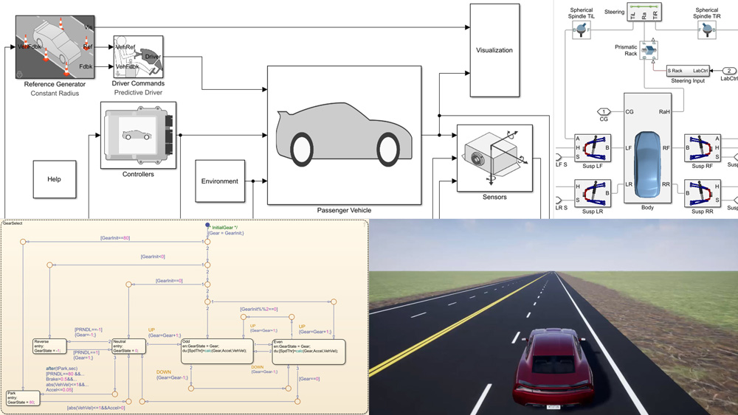
Model-BASED Design (MBD)
PART III: ADAS SYSTEM Modeling and Testing

Slide 10
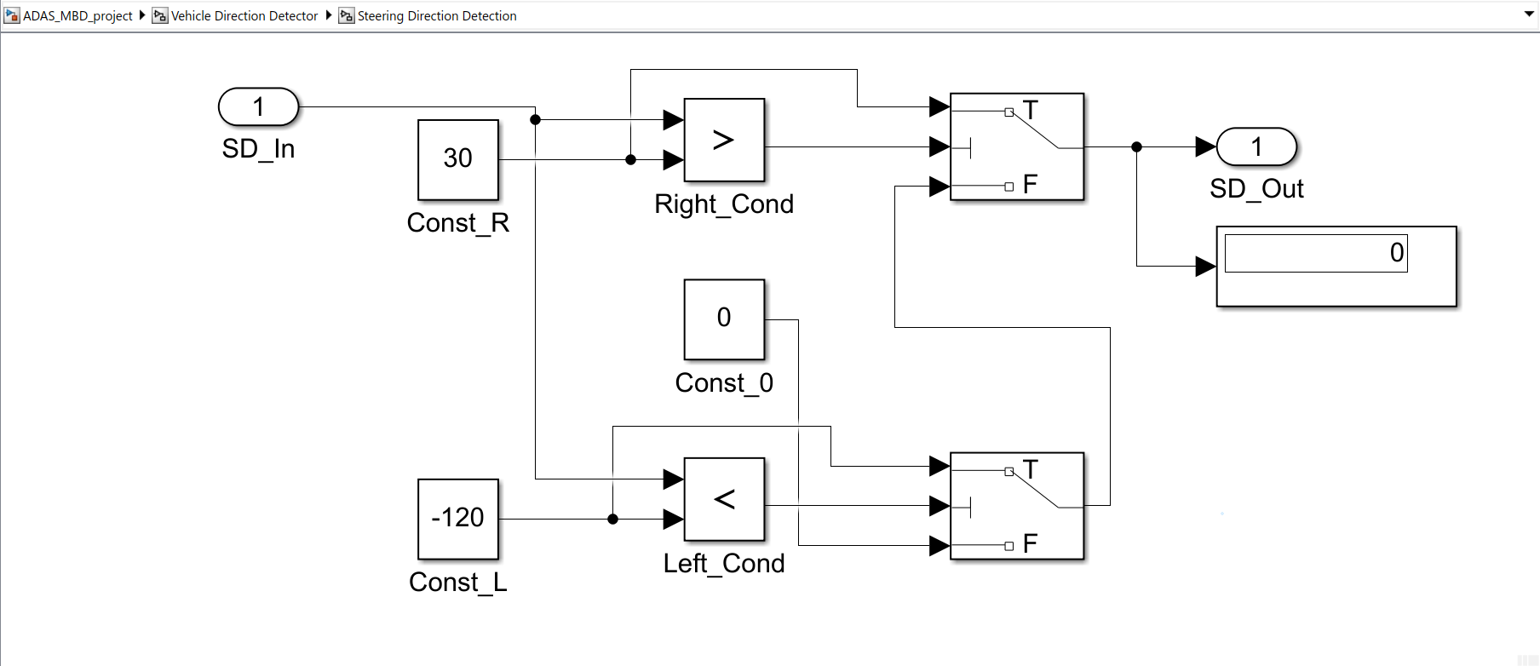
System Modeling with MATLAB Simulink
✅ Why Use Simulink for ADAS?
Graphical environment for real-time simulation
Enables system-level testing before hardware implementation
Supports Model-Based Design (MBD)
✅ Simulink Model Components
Steering Direction Detection Subsystem (Shown here)
Turn Confirmation Subsystem
Inputs/Outputs: Yaw Rate, Road Sign, Direction Indicator

Slide 11
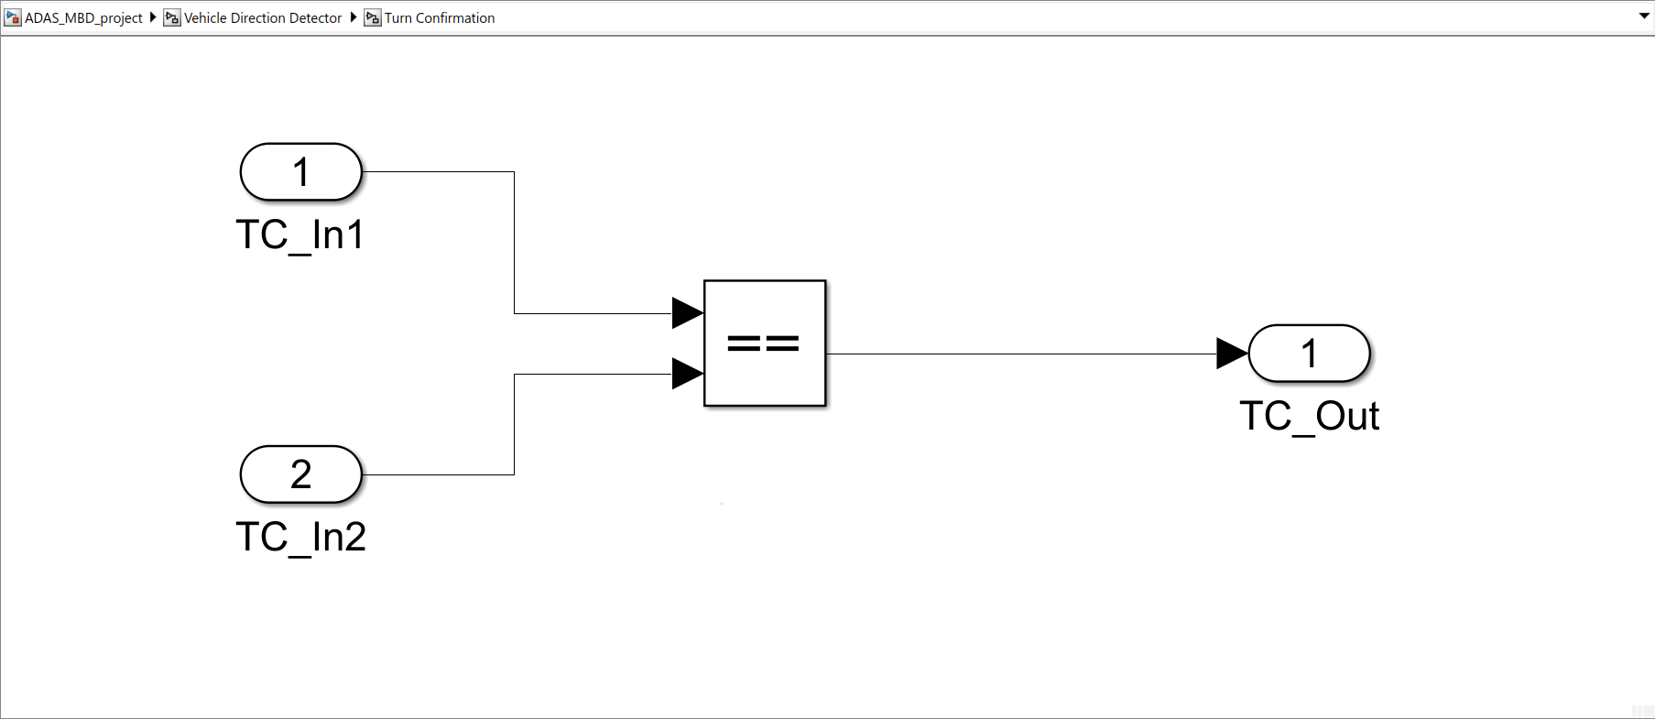
System Modeling with MATLAB Simulink
✅ Why Use Simulink for ADAS?
Graphical environment for real-time simulation
Enables system-level testing before hardware implementation
Supports Model-Based Design (MBD)
✅ Simulink Model Components
Steering Direction Detection Subsystem
Turn Confirmation Subsystem(Shown here)
Inputs/Outputs: Yaw Rate, Road Sign, Direction Indicator

Slide 12
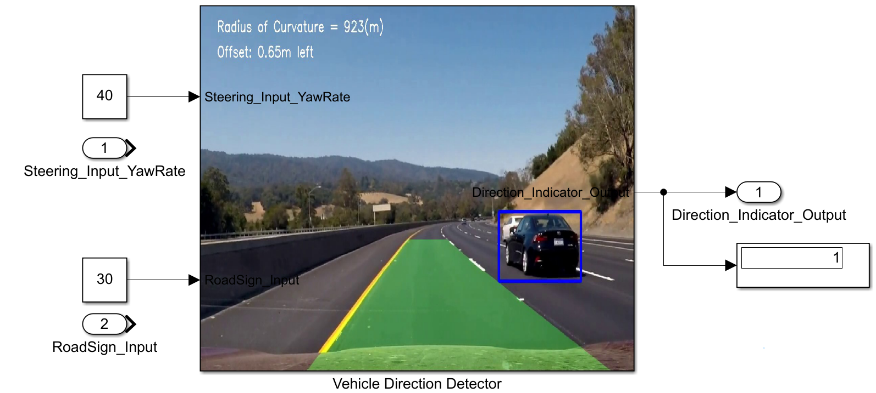
🧪 Model-in-the-Loop (MIL) Testing:
Model-based testing is crucial for verifying the accuracy and robustness of the control logic.
✅ What is MIL?
Model-in-the-Loop (MIL) ensures that the Simulink model logic is correct before code generation.
Uses test cases to verify system behavior.
✅ MIL Test Cases for ADAS:
Test Case | Steering Input | Road Sign Input | Expected Output
1 | 40 (Right) | 30 (Right) | ✅ 1 (Correct)
2 | -130 (Left) | -120 (Left) | ✅ 1 (Correct)
3 | 10 (Straight) | 30 (Right) | ❌ 0 (Mismatch)

Slide 13
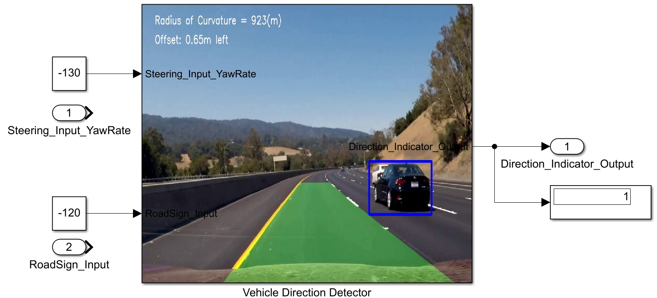
🧪 Model-in-the-Loop (MIL) Testing:
Model-based testing is crucial for verifying the accuracy and robustness of the control logic.
✅ What is MIL?
Model-in-the-Loop (MIL) ensures that the Simulink model logic is correct before code generation.
Uses test cases to verify system behavior.
✅ MIL Test Cases for ADAS:
Test Case | Steering Input | Road Sign Input | Expected Output
1 | 40 (Right) | 30 (Right) | ✅ 1 (Correct)
2 | -130 (Left) | -120 (Left) | ✅ 1 (Correct)
3 | 10 (Straight) | 30 (Right) | ❌ 0 (Mismatch)

Slide 14
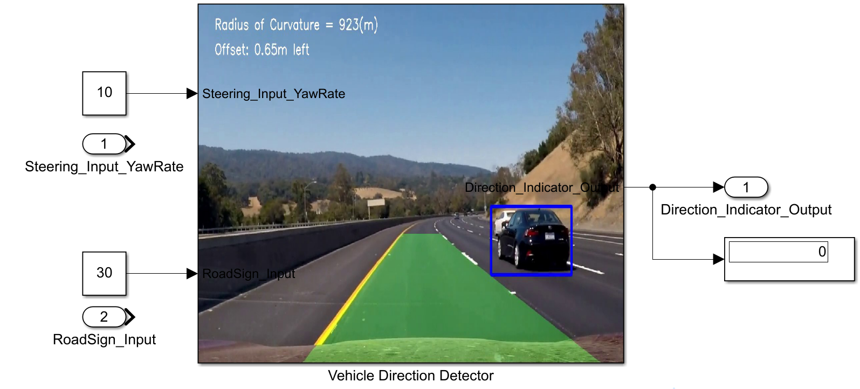
🧪 Model-in-the-Loop (MIL) Testing:
Model-based testing is crucial for verifying the accuracy and robustness of the control logic.
✅ What is MIL?
Model-in-the-Loop (MIL) ensures that the Simulink model logic is correct before code generation.
Uses test cases to verify system behavior.
✅ MIL Test Cases for ADAS:
Test Case | Steering Input | Road Sign Input | Expected Output
1 | 40 (Right) | 30 (Right) | ✅ 1 (Correct)
2 | -130 (Left) | -120 (Left) | ✅ 1 (Correct)
3 | 10 (Straight) | 30 (Right) | ❌ 0 (Mismatch)

Slide 15
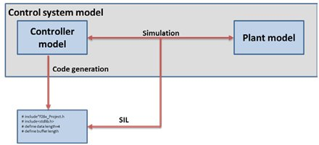
💻 Software-in-the-Loop (SIL) Testing:
✅ What is SIL?
Software-in-the-Loop (SIL) runs the generated C/C++ code from Simulink in a simulated environment.
Ensures the generated code functions correctly and matches the model behavior.
✅ SIL Validation Process:
Generate C Code from Simulink.
Run the compiled SIL test cases in MATLAB.
Compare SIL output vs. MIL output.

Slide 16
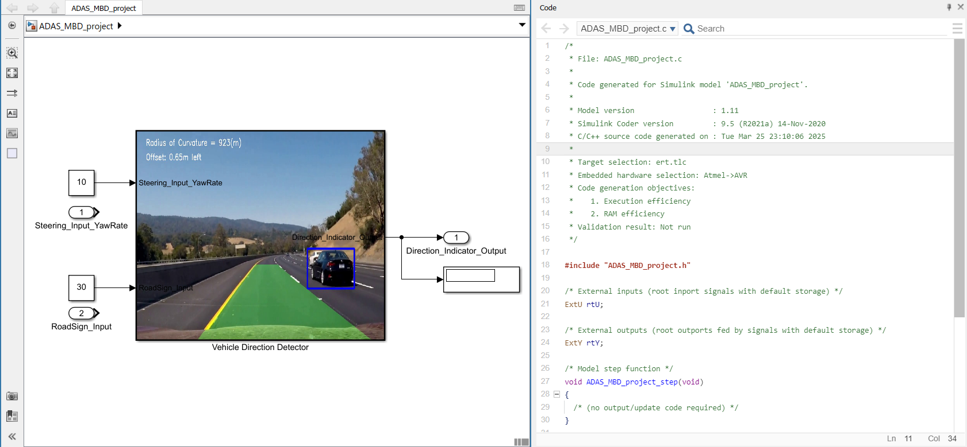
💻 Software-in-the-Loop (SIL) Testing:
After validating the model, it’s time to test the generated code.
✅ SIL Test Steps:
Integrate the Auto-Generated Code into a virtual ECU environment.
Re-run Test Cases from MIL to ensure the behavior is consistent.
Monitor Real-Time Performance: Check the system's ability to detect faults without compromising speed.

Slide 17


Thank YOU 😇🤗🌹 Project GitHub repo QR Code

